Slide 1
Domotic house
Carlos Carretero Rubio
Carmen Córdoba Fuentes
Irene Fernández Ojeda
Inmaculada Rodenas Felipe

Slide 2
Hello song
Hello, Hello, How are you? How are you?
Hello, Hello, I´m good, I´m good
Hello, Hello, How are you? How are you?
Let´s start the day
Let´s start the day

Slide 3
Story
WHERE IS BOB?

Slide 4
Reading

Slide 5
Writing

Slide 6
Listening
Secret code

Slide 7
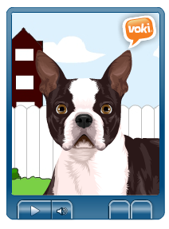
Oral interaction

Slide 8
Cut out

Slide 9
Song

Slide 10
Song
There’s a kangaroo in my………. bathroom/ kitchen/ garden.
B) There’s a hippo in my………… hall/ bed/ toilet.
C) There’s a dinosaur in my…….. garden / living room/ dining room.
D) There’s a tiger in my………… hall/ toilet/ tree.
E) There’s a lion in my…………. Bedroom/ bathroom/ living room.

Slide 11
Final Task

Slide 12
Good bye song
Clap your hands
Stamp your feet
It's time to say good-bye to all my friends. It's time to say good-bye to all my friends. Oh, it's time to say good-bye. Give a smile and wink my eye.
It's time to say good-bye to all my friends.

