Slide 1
“FREE TIME” 5º PRIMARY
GROUP 2
Mª DOLORES CORTÉS BIOSCA
LAURA GONZÁLEZ GARCÍA
BEATRÍZ MEJÍAS LEO
IGNACIO RODRIGUEZ ORTEGA

Slide 2
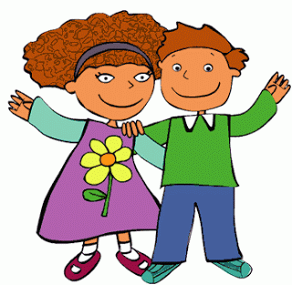
Hello routine
Hello children, hello children
How are you? how are you?
I’m fine thank you I’m fine thank you
What about you?

Slide 3
Storytelling
HOLLY´S DREAM

Slide 4
QUESTIONS
1. What is the name of the girl?
a) Alice b) Holly c) Lisa
2. How does she feel?
b) Happy b) Hungry c) Bored
3. Where did she go?
a) To the tree house b) To the cinema c) To the bar
4. What did she find in the park?
a) A car b) Children c) Her parents
5. What happened at the end?
a) Children were bored
b) Children were crying
c) Children were happy

Slide 5
Do something different!

Slide 6
Do Something Different!
Try a new ,
Learn a new fact,
Find a fun game to play.
Learn a new skill,
a new friend,
Do something today!
sport
new
make
different

Slide 7
Chours:
Do something different,
Have lots of
It´s amazing to try something new.
Do something different,
Have lots of fun.
There are so new things to do!
fun.
many

Slide 8
Try a new
Read a new book,
some great new words to say.
a new film,
See a new
Do something different today!
food,
learn
Watch
place,

Slide 9
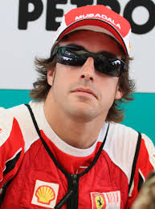
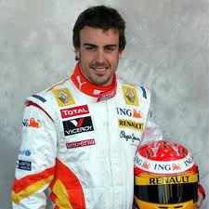
Art Attack
NAME:
________________________
JOB:
________________________
WHAT IS HE DOING?
________________________
________________________
________________________
________________________
________________________

Slide 10
Listen to Billy
Hello children.
My name is Billy and I do a lot of things in my
On Saturdays I , but I don´t play .
In the afternoon I like a book but not l
Then I usually go to the with my friends to walk the
. After all I come back to my house and a film with my http://www.voki.com/php/viewmessage/?chsm=6bb59aec408dbaf9abdd6f38c592f210&mId=1998369
FREE TIME
PLAY FOOTBALL
BASKETBALL
READING
LISTENING TO MUSIC
PARK
DOG
WATCH
FAMILY

Slide 11
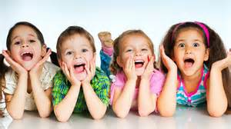
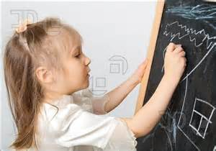
PICTIOACT
Groups of 4 pupils with a person who represents the group
Throw the dice and take the corresponding target
Draw in the blackboard or act what is said in the target. The group should guess it.

Slide 12
The mixture

Slide 13
LET´S MAKE AN INTERVIEW -Final task-

Slide 14
FACE2FACE!
With…

Slide 15
CRISTIANO RONALDO

