Slide 1
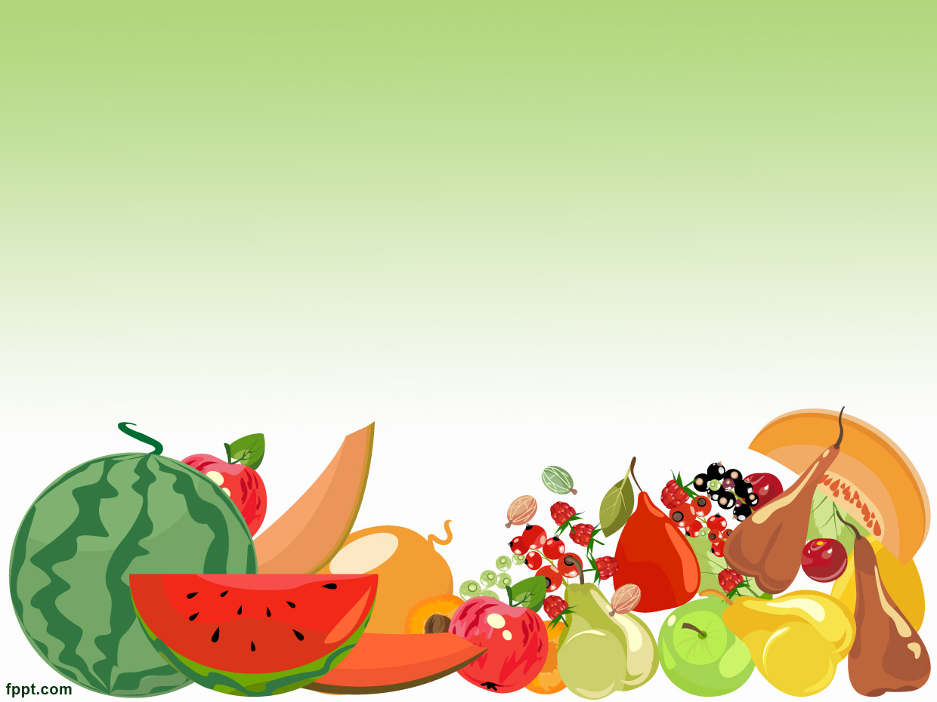
FOOD
Group 3
Mª Emilia Castillo
Cristina Díez Arcal
María Navarro Fernández
Muhammet Okur
Didactic of the English Lnaguage 2013/2014

Slide 2
HELLO SONG
HELLO ROUTINE
GROUPING | TIMING | MATERIALS
The whole class | 5 minutes | Hello song
Development. Every day when they come to the class, they will be in a circle and we will sing together the following How are you song with our mascot Beheeeee.
TAPESCRIPT Hello, hello, how are you? (2) I’m fine, I’m fine, thank you and you?

Slide 3
STORY
A YUMMY CAKE
GROUPING | TIMING |  | MATERIALS
The whole class | 8-10 minutes. |  | Puppets
Development. The teacher will tell the story A yummy cake! to the pupils. Before that, we will introduce the characters with puppets.
TAPESCRIPT This is Jimmy and this is his mummy. One day, Jimmy says to his mummy Jimmy. Mummy, mummy! I’m hungry! Mummy. Ok, Jimmy. Look at there! We have an apple. Jimmy. Yes, mummy. A red apple, yummy! Apple. Not me, Jimmy! Not me! Mummy. We have milk. Jimmy. Yes, mummy. We have milk. Milk. Not me, Jimmy! Not me! Mummy. We have a pear. Jimmy. Yes, mummy. A green pear, yummy! Pear. Oh! Not me, please! Not me! |  | Mummy. We have an egg. Jimmy. mmm, mummy, an egg! Egg. Not me Jimmy, not me! Mummy. We have a banana. Jimmy. yes, mummy, a yellow banana! Banana. oh! Not me, please! Not me! Mummy. We have some of bread. Jimmy. mmm, bread! Yummy, yummy! Bread. Not me, Jimmy! not me! Jimmy. Oh, mummy… But I’m hungry! Mummy. Ok Jimmy. lets make a cake! Then all the fruits jumped into the cake.

Slide 4
CHANT
A FOOD RAINBOW
GROUPING | TIMING | MATERIALS
The whole class | 3 minutes. | Flashcards
Development. The teacher will song this chant before doing the following activity. The purpose is that children know that we are going to change the activity. Thus the teacher will catch the attention and interest of the pupils.
TAPESCRIPT Let’s make a rainbow! A food rainbow! Red apples, yummy! Put them in your tummy! Oranges, yummy! Put them in your tummy! Yellow bananas, yummy! Put them in your tummy! Green pears, yummy! Put them in your tummy! I have a food rainbow in my tummy!

Slide 5
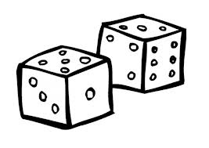
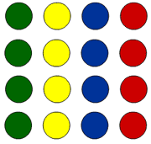
TWISTER
KEEP A BALANCE
GROUPING | TIMING | MATERIALS
2 groups | 10 minutes. | 2 dices Bracelets with animals A board
Development. We will have two dices, one dice with colors and another one with some food items. Each pupil will has four bracelets (an tomato bracelet, a cake bracelet, a cheese bracelet and a carrot one) and they will have to put them in their wrists and in their ankles, respectively. A child will turn around the two dices and children will have to do what the dices order (put the tomato on the green color).

Slide 6
SPEAKING/ORAL INTERACTION
THE MAGIC BAG
GROUPING | TIMING | MATERIALS
The whole class | 10 minutes. | Magic bag Flashcards
Development. The different flashcards will be introduced by taking them out of the Magic Bag. The names of food items are repeated with different intonation. Then the teacher will ask them different questions (is it a banana?, what is it?) in order to check the assimilation of vocabulary.

Slide 7
ICT ACTIVITY
MEMORY GAME (CUADERNIA)
GROUPING | TIMING | MATERIALS
The whole class | 5-8 minutes. | Althia room
Development. Children have to look for the partner for each food item that appears on the screen. They have to pay attention and remember where is each picture to make a couple of food. The game finishes when they have paired all the pictures. https://www.dropbox.com/s/89szczbed95o78c/libro_pc_foodcouple_89395.zip

Slide 8
WRITING
THE FOOD DICE
GROUPING | TIMING | MATERIALS
In pairs | 5 minutes. | A food dice Poster Flashcards
Development. There will be a dice with some food items. Children will take turn rolling the dice. When the dice stops rolling, they will look at the food on top and they will have to say what item has appeared. On the other hand there will be different food flashcards and a mural in the wallet with different silhouettes which correspond with the food items of the dice. Children will have to put the flashcard which corresponds with that one the dice shown and put it in her silhouette.

Slide 9
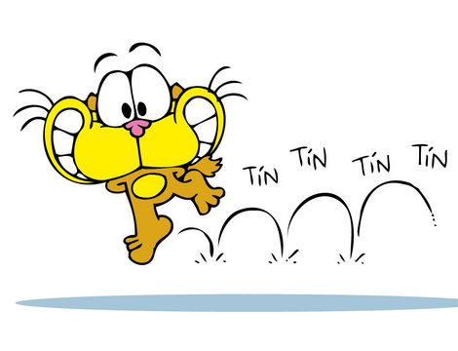
LISTENING
JUMP!
GROUPING | TIMING | MATERIALS
Indıvıdual work | 5-8 minutes. | Big flashcards
Development. Big flashcards of food items will be laid on the floor. The teacher or a confident student will say: jump on the banana! jump on the cheese! and the children will have to jump on the corresponding picture.

Slide 10
READING
READ A YUMMY CAKE!
GROUPING | TIMING | MATERIALS
Individual work | 30 minutes (divided in two sessions) | Scissors Color pencils Stapler Pictures sheets
Development. Each child will have a sheet of story’s pictures. They will have to color the pictures, cot out them and order the pictures like appear on the story. Then, the teacher will staple all the pictures together. Children will take the book to their houses for showing and telling it to their parents.

Slide 11
FINAL TASK
SHOPPING TIME
GROUPING | TIMING | MATERIALS
The whole class | 15 minutes | Game
Development. This game is a board game. We will make groups of four and we will distribute to each pupil a shopping list with the food he/she has to buy and a chart to “carry” the food. Then, on a board, we will put little cards with pictures of food, but they will be upside down. In each turn, a child has to take one card, show to the others saying the right word and decide if he/she wants to keep it. If it has this item in the shopping list, he will keep it, if not, he will put it back on the board, but upside down, so the others interested in this card, will have to memorise where it is.

Slide 12
GOODBYE SONG
GOODBYE ROUTINE
GROUPING | TIMING | MATERIALS
The whole class | 5 minutes | Goodbye song
Development. Every day at the end of the class we will sing the goodbye routine with Beheee to say goodbye to everyone.
TAPESCRIPT Goodbye, goodbye, goodbye to you! Goodbye, goodbye!I see you again! (2)

Slide 13
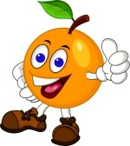
Thanks for your attention!

