Slide 1
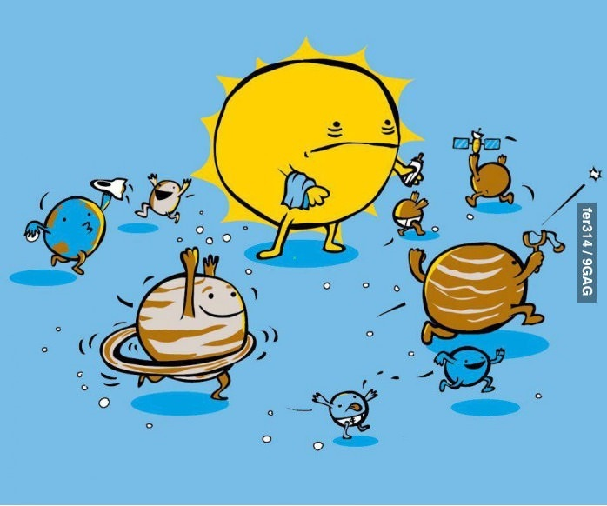
A TRIP TO THE PLANETS!
GROUP 8
ESTELA ÁLVAREZ
RAQUEL GONZÁLEZ SÁNCHEZ
FRANCISCO LÓPEZ
ANTONELLA MARTELON GLARIA.

Slide 2
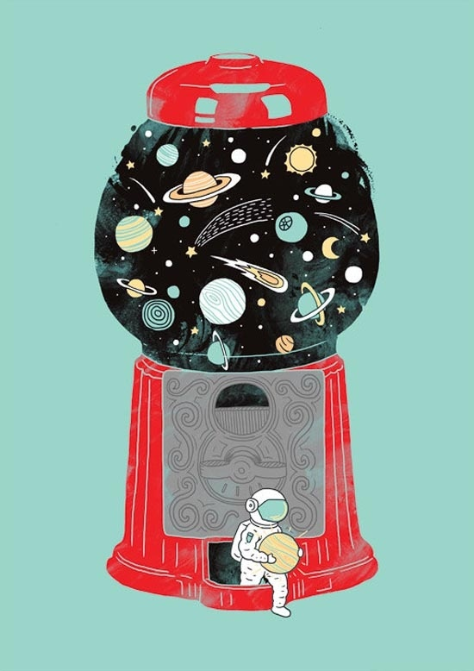
INDEX
Story “A trip to the Planets!”
Song: Solar system song.
Final task: Space Quiz.
Some other activities!

Slide 3
STORY: A trip to the planets!

Slide 4
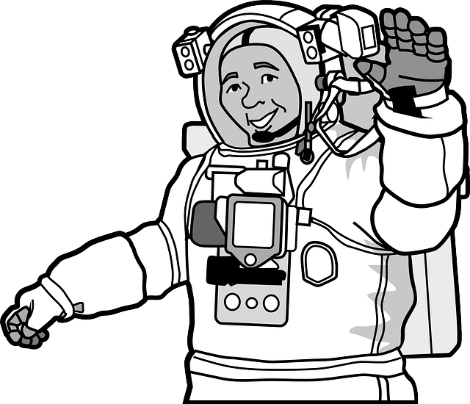
Bob the astronaut and his assistant Betty the Monkey wanted to visit all the planets of the solar system. They started their space trip on the biggest and the fastest spaceship of our planet Earth.
Bob: Betty, the trip to Mars is long and I’m so tired! I’m going to sleep a little bit. HmmmmZZZZZZZZZZzzzzzzzzz
-Ohhh Where are we!? Betty? What planet is it? Is it Mars?
Betty pointed to letter V on the keyboard.
-Oh!! We are close to Venus! We are lost!
-Oh! Look! A message from the Earth!

Slide 5
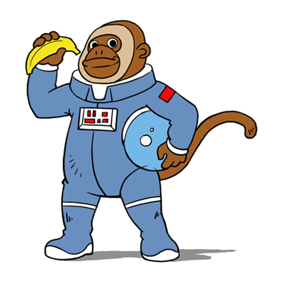
“Piiiiiiiiiiiiiiiiiiiiiiiiiiiiiiiiiiiiiiiiiiiiii!!!!! Bob, you must follow the next code: My Very Educated Mother Just Served Us Nachos. Good luck!”
Bob and Betty look at each other.
Bob: My Very Educated Mother Just Served Us Nachos? What does it mean?
Bob wrote the code on the blackboard.
Betty: Hmmmmmm! Betty pointed to the Capital letters.

Slide 6
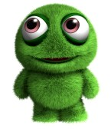
Bob: -Betty! You are so clever! It is the planets order! We go the Earth!
“My Very Educated Mother Just Served Us Nachos.”
“Mercury, Venus, Earth, Mars, Jupiter, Saturn, Uranus and Neptune! That’s it!
-Hey you! From the Earth! Could you help us to order the planets please? We want to go to the Earth!
(Students help us to order the planets)
- So, Mercury is the nearest to the Sun and, Venus, Earth, Mars, Jupiter the biggest, Saturn, Uranus and Neptune!
- Hurrah! Well done, Betty! We go back home! Great job! Take a banana!
Betty: Yummy!!!!
Bob: -Look Betty, the Earth! No, no… it’s an alien. We are in Mars…Hello Mr. alien!-
Alien: -Hello Bob! How are you?-
Bob: -Fine thanks! We go to the Earth!
Alien: -Oh! Have a nice trip! See you!
Bob: -Bye Mr. Alien!
And finally Bob the astronaut and Betty the monkey
arrived on the Earth in time for dinner.

Slide 7
Answer the following questions…
Who are the main characters?
Why they didn’t arrive to Mars?
Do you remember the CODE?
What does the code means?

Slide 8
SONG: solar system
LISTEN AND FILL IN THE GAPS.
http://www.youtube.com/watch?v=tNlhqPz5-Kw

Slide 9
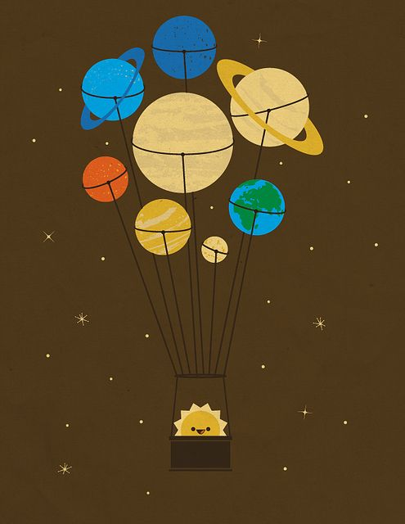
We live in the Solar System
In the centre is the Sun
All the planets move around it
We’ve seen every single one
Orbit in the big bright Sun (x2)
Planets in the solar system
1, 2, 3, 4, 5, 6, 7, 8
Telescope they help us to see them
We’ve seen every single one
Orbit in the big bright Sun (x2)
Mercury, Venus and Earth
And Mars and Jupiter and Saturn
Uranus too…
And don’t forget that pretty blue…Neptune
We live in the Solar System
In the centre is the Sun
All the planets move around it
We’ve seen every single one
Orbit in the big bright Sun (x2)

Slide 10
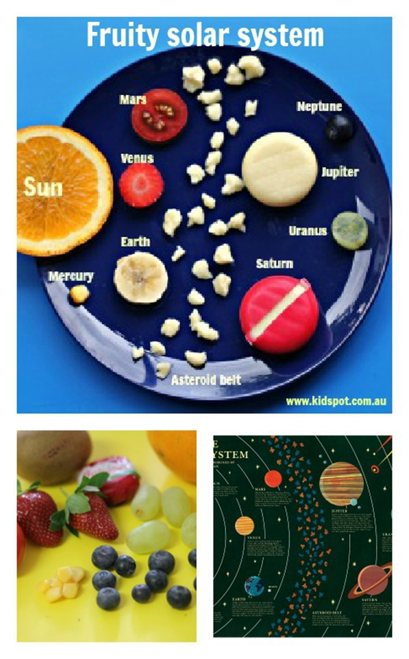
FINAL TASK: Space Quiz!
INSTRUCTIONS :
pay attention and listen to some questions…
If you fail, the next turn will be for the next group and they will pick the fruit up and put it for the construction of the mobile. http://www.voki.com/pickup.php?scid=9100443&height=267&width=200
if you answer is the correct one you can pick up one fruit and help it to build up a Solar System recipe.

Slide 11
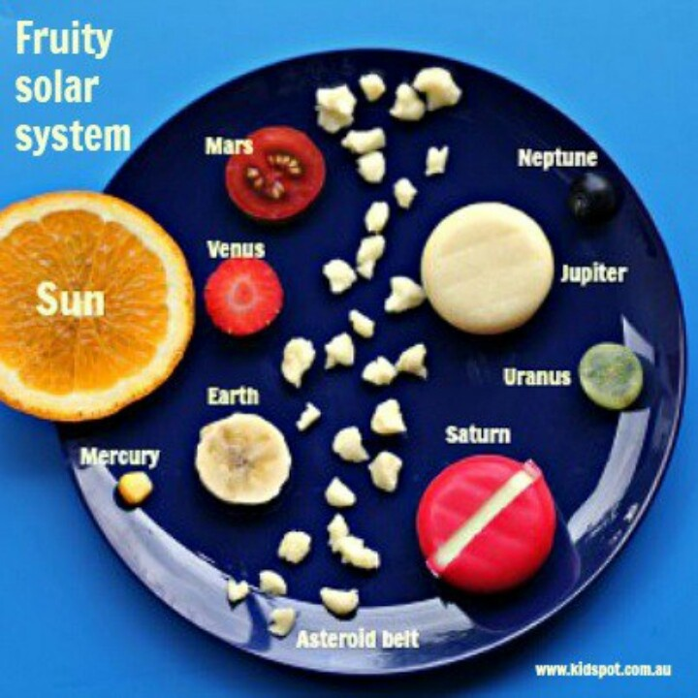
QUESTION 1
Which is the nearest planet from the Sun?
Venus
Mercury
Jupiter

Slide 12
QUESTION 2
Which is the biggest planet?
Earth
Saturn
Jupiter

Slide 13
QUESTION 3
Which element of the Solar System is
the brightest?
The Sun
The planets
Monkey

Slide 14
QUESTION 4
Which planet is between Venus and Mars?
Earth
Mercury
Uranus

Slide 15
QUESTION 5
Which planet has got some rings?
Earth
Neptune
Saturn

Slide 16
QUESTION 6
How can you trip to the planets?
We can’t
With a spaceship
Flying

Slide 17
QUESTION 7
Which is the smallest planet of the Solar System?
Uranus
Saturn
Mercury

Slide 18
QUESTION 8
Which is the pretty blue planet?
Neptune
Mars
Venus

Slide 19
QUESTION 9
How many planets are there in the Solar System?
2
8
5

Slide 20
QUESTION 10
Which is the last planet?
Uranus
Pluto
Neptune

Slide 21
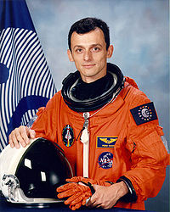
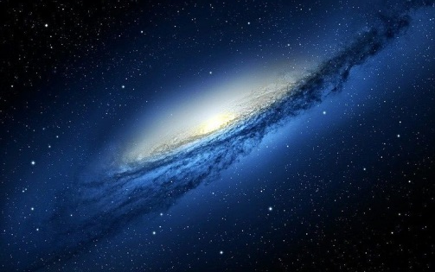
OTHER ACTIVITIES
Grammar activity
Listening http://dearstudents2012.blogspot.com.es/2013/12/group-8-lim-activity.html
Reading and writing activity http://photopeach.com/album/pu05a1?invitecode=82fc419e82

Slide 22
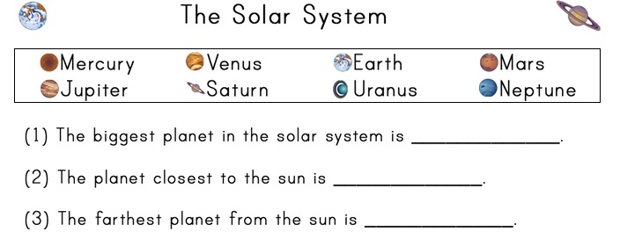
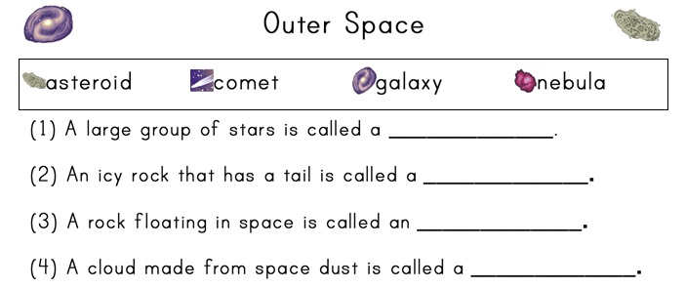
READING WORKSHEET

Slide 23
bibliography
http://www.youtube.com/watch?v=tNlhqPz5-Kw
http://www.voki.com/pickup.php?scid=9100443&height=267&width=200
http://www.voki.com/pickup.php?scid=9100443&height=267&width=200
http://photopeach.com/album/pu05a1?invitecode=82fc419e82

Slide 24
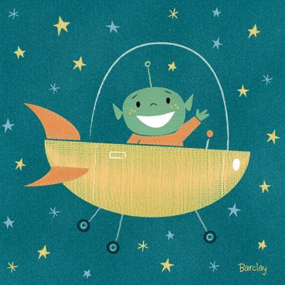
That’s All !!! Thank you!
SEE YOU

