Slide 1
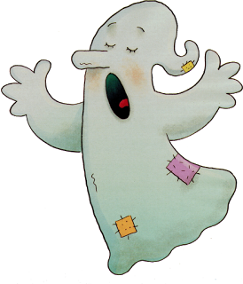
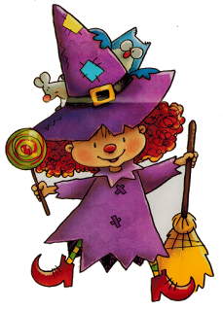
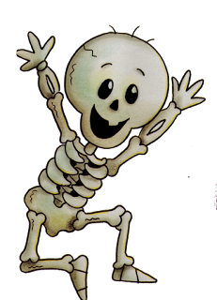
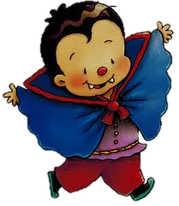
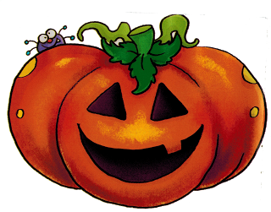
HALLOWEEN’S PARTY

Slide 2
HELLO SONG
Hello, hello how are you today?
I´m happy, happy, happy
Hello, hello how are you today?
I´m sad, sad, sad
Hello, hello how are you today?
I´m hungry, hungry, I´m hungry today!
ñam, ñam, ñam

Slide 3
STORY TELLING

Slide 4
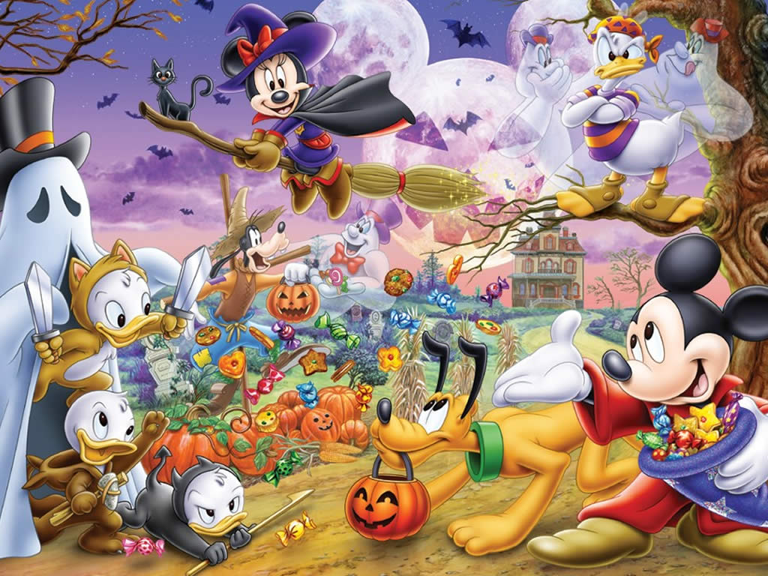
Activity : “WHO IS MISSING?”
WRITING
Timing 10 minutes | Materials: Flashcards | Grouping: all the class
Development: We put flashcards with the characters about Halloween on the blackboard. We say to children that they need to close their eyes and we take away a character. When children open their eyes they have to guess the character who is missing.

Slide 5
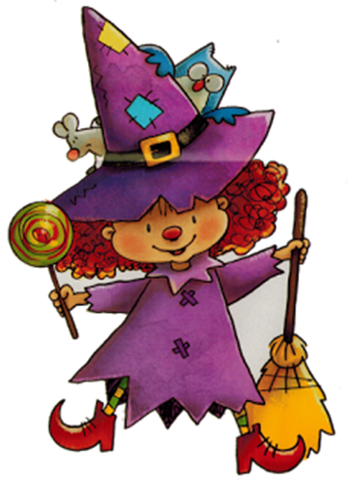
ACTIVITY: “DRESS ME UP”
LISTENING
Timing: 10 minutes | Materials: the characters of the story | Grouping: All the class
Development: children have the body of the characters in the story and we say to children what dress they have to take and dress up the character with the correct dress.

Slide 6
CHANT: “WHO TOOK THE CANDY?”
ORAL INTERACTION
Timing: 10 minutes | Materials: Flashcard and Pumpkin | Grouping: All the class
Development:we give to children the pumpkin and a flashcard with a character. They have to make a circle. They have to pass the pumpkin to the child on their right singing the chant, and when the song end children have to say the name of the child who has the pumpkin and the character and “has the candy”. If the child doesn’t have the candy we continue with the song. Who took the candy from the pumpkin’s head? Who took the candy from the pumpkin’s head? Gema ghost has the candy. No!

Slide 7
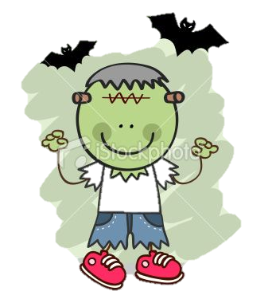
ACTIVITY : “Who are you?”
ORAL INTERACTION
Timing: 15 minutes | Materials: Flashcard an gomets | Grouping: All the class
Development: Children are around the class, every child has a flashcard, for instance: happy ghost or sad monster. They have to ask to their partners: “Who are you?” and they have to answer . They have to find their pair. Finally they have to match all the pictures.

Slide 8
ACTIVITY : Cut Bat
WRITING AND READING
Timing: 20 minutes | Materials: 2 different copies , glue, scissors | Grouping: Individual
Development: Bat Copy: Children have to cut out around the bat, and in the bottom children have to cut out two circles to introduce their fingers. Halloween patterns: Children have to cut the pictures and put in the correct series.

Slide 9
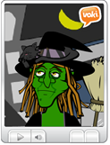
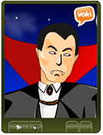
ACTIVITY: “How are you?
LISTENING
Timing: 10 minutes | Materials: PC,copies | Grouping: All the class
Development: First teacher give to the children one copy with Halloween pictures related with the vocabulary. But in this pictures there isn´t a face, because children have to discover how is this picture but first they have to listen to the voki and choose the best answer, something like this: http://www.voki.com/php/viewmessage/?chsm=4f4a1d9c5eec72a6f43bb68328b189d4&mId=2046539 http://www.voki.com/php/viewmessage/?chsm=61c8df072c45f05b82c14536b618092f&mId=2046552 http://www.voki.com/php/viewmessage/?chsm=cefc4671b5eed3ec748e3a00aa7758fc&mId=2046566 http://www.voki.com/php/viewmessage/?chsm=137b68b3ccdf8f1ff2155c41d0227f53&mId=2046681

Slide 10
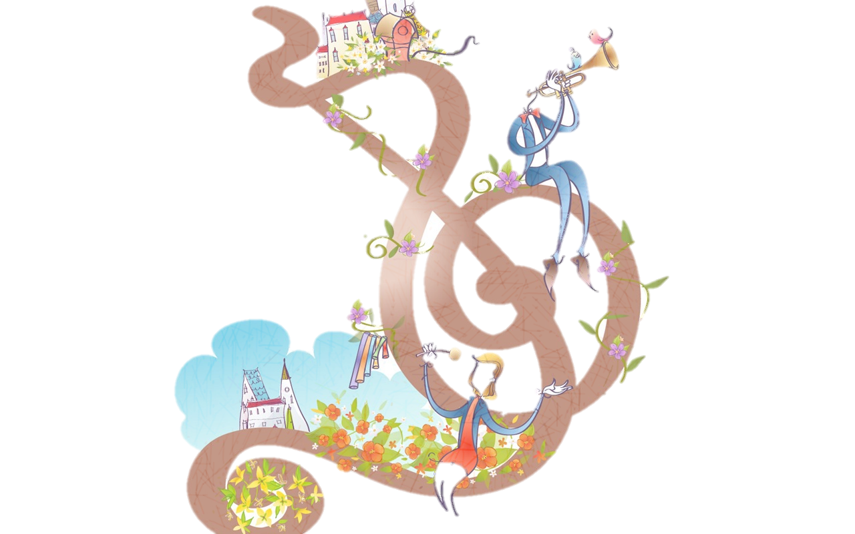
.
SONG
Knock knock, trick or treat?
Who are you?
I'm a ghost. I'm a little ghost.
Knock knock, trick or treat?
Who are you?
I'm a witch. I'm a little witch
Knock knock, trick or treat?
Who are you?
I'm a skeleton. I'm a little skeleton
Knock knock, trick or treat?
Who are you?
I'm a monster. I'm a little monster.
Knock knock, trick or treat?
Who are you?
I'm a pumpkin. I'm a little pumpkin

Slide 11
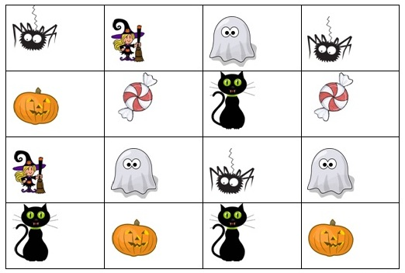
ACTIVITY: “Halloween stickers”
WRITING
Timing 10 minutes | Materials: table with the pictures. | Grouping: individual
Development: we give to children one copy with the table and pictures of Halloween characters. We say a number and a character and children have to put a sticker where they find the character that we say.

Slide 12
ACTIVITY: “Bingo”
READING
Timing 10 minutes | Materials:flashcards with pictures of the characters and copies. | Grouping: individual
Development: First teacher give to the children one copy with a Halloween bingo related with the vocabulary, for example a ghost, witch, pumpkin, monster, etc. Teacher throws the dice and then says the word that has appeared in the dize. Children how have this picture have to make a cross or put a sticker inside and the winner will be the child who has a cross or a sticker in each picture.

Slide 13
Activity : “3,2,1 action”
FINAL TASK
Timing :20 minutes | Materials: pictures, colors and computer | Grouping: all the class
Development: children have to color the pictures. Then with the help of the teacher they have to record their voices. Finally the teacher has to create a movie with movie maker.

Slide 14
Goodbye Song
Goodbye goodbye, I see you again
Goodbye goodbye, I see you my friends
Goodbye goodbye, I have fun today
I have fun today!

