Slide 2
Egypt
Here we can find the big pyramids and the longest river in the world, the river Nile.
Their first stop is Egypt.

Slide 3
After some days, they arrive in India, where they meet a girl.
India
Hello, my name is Romy. Who are you? Where are you going?

Slide 4
Willy Fog, Rigodon, Tico and their new friend Romy travel by ship until they arrive in China.
What’s that?
It’s really long!
China

Slide 5
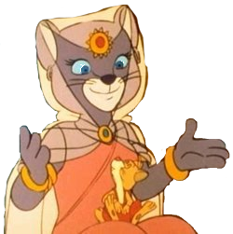
Japan
This is so beautiful! There are millions of flowers!
The four friends arrive in Japan. They have just 30 days left to go to London, so they must hurry up.

Slide 6
After many days, they see land.
Yes! I like this country. We can see some of the most beautiful beaches in the world!
Mexico

Slide 7
United States
Yes! Some of the highest buildings in the world are in the United States, in cities as Chicago or New York. I love these cities!
They take a train to cross America and go to Chicago and New York, in the United States of America.

Slide 8
United
Kingdom
We did it!
After eighty days, everybody is waiting for Willy Fog and his friends in London. They think Willy Fog will lose, but then, a boat appeared in the River Thames.

