Slide 1
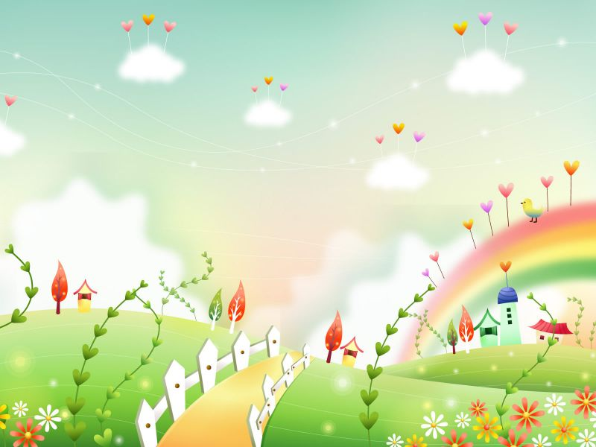
Froggy goes to school
GROUP 2:
MARÍA ARAQUE
JAVIER ALFARO
GEMA MARTÍNEZ
BEATRIZ LOZANO

Slide 2
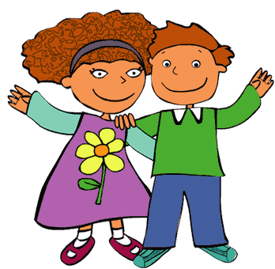
Hello routine
Hello, hello, hello everyone
Hello, hello, hello everyone
Hello children, hello Froggy
Hello children, hello Froggy
Hello, hello, hello everyone.

Slide 3
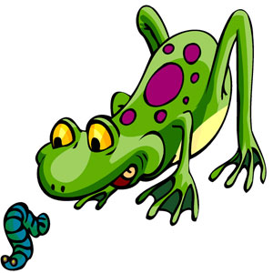
Session
Speaking
Activity 1: Where is Froggy?
Duration: 10 minutes | Materials: A house | Grouping: All the class
Development: We put a big house on the wall. The house has some windows with numbers, inside the windows there are animals, and children have to say a number and open the windows. They have to find Froggy.

Slide 4
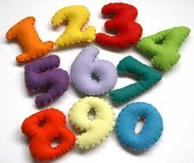
Session
Speaking and listening
Activity 2: Hand number
Duration: 5 minutes | Materials: puppets | Grouping: All the class
Development: We give children numbers from 1 to 5, and they have to put numbers in their fingers. Then we say the number that children need to show. Children need to count all the numbers.

Slide 5
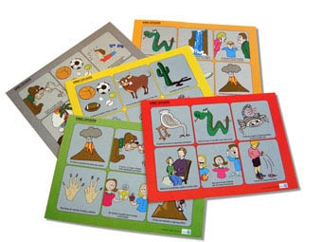
Session
Writing and listening
Activity 3: Bingo
Duration: 10 minutes | Materials: Flashcards | Grouping: Individual
Development: We give the children a copy with numbers and animals, then children have to put sticker in the picture that we say. When children have asticker in all the pictures they need to say bingo.

Slide 6
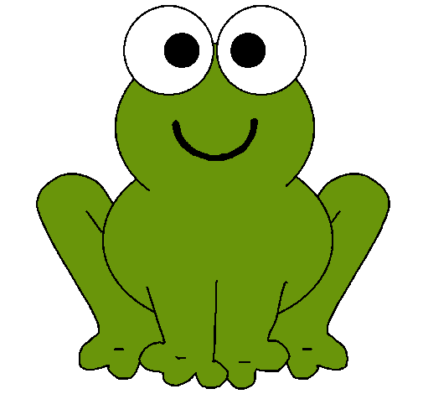

Slide 7
2

Slide 8
5

Slide 9
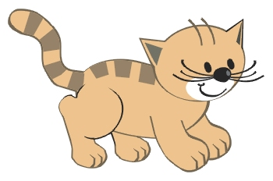

Slide 10
4

Slide 12
3

Slide 13
FINAL TASK

Slide 14
Physical Education
“Five Little Froggies”
Two little froggies sitting on a well One looked up, and down he fell. Froggies jumped high. Froggies jumped low, low, low.
One little froggy sitting on a well He looked up and down he fell.

Slide 15
SCIENCE

Slide 19
Goodbye routine
Good bye, good bye, good bye everyone
Good bye, good bye, good bye everyone
Good bye children, good bye Froggy
Good bye children, good bye Froggy
Good bye, good bye, good bye everyone

